Slide 1


Smart Librarian
ONN WEI CHENG A0092201X
YANG JIESHEN A0003901Y
NIRAV JANAK PARIKH A0213573J
ISA-PM-IPA-2021-01-09-IS02PT
https://ychef.files.bbci.co.uk/976x549/p03gg1lc.jpg

Slide 2


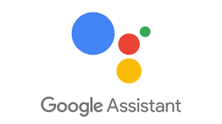





System Architecture
User Input & Output
Conversational UI
RPA Controller
User Intent Handling
NLB Availability Checker
Intelligent Title Matcher and Abstract Summary
Amazon Recommendation System
Input from user through text or voice
Response Handling
Email for User

Slide 3

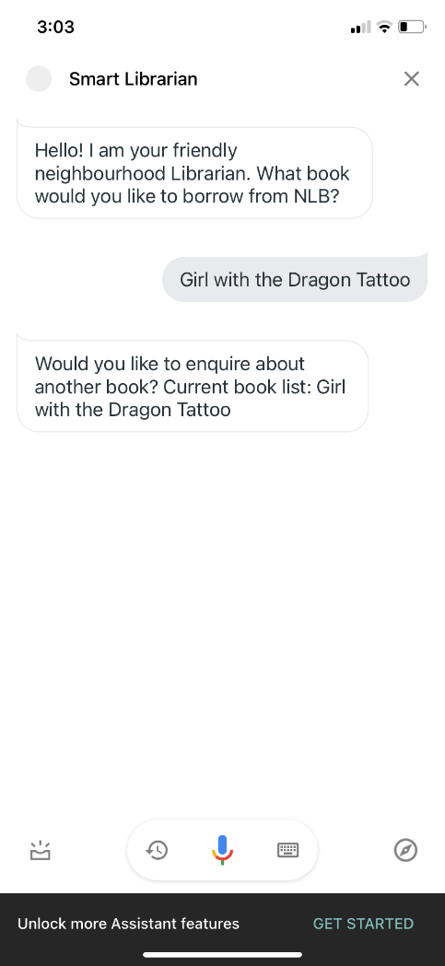

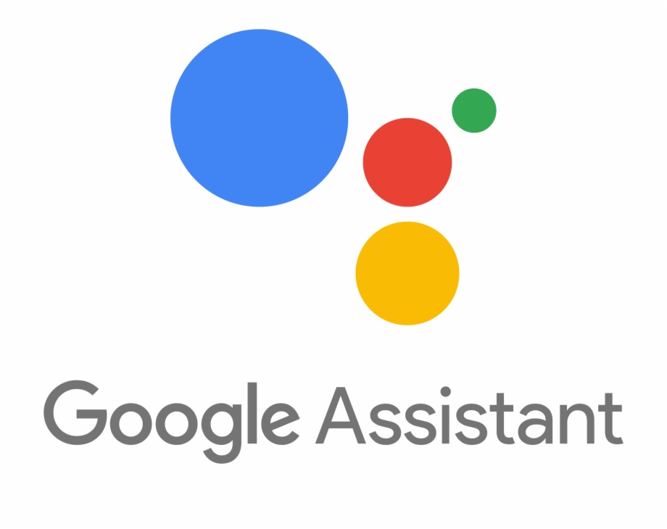
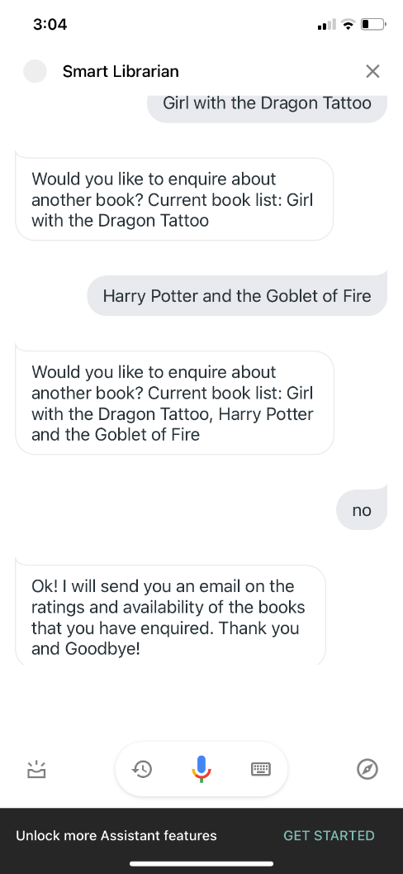
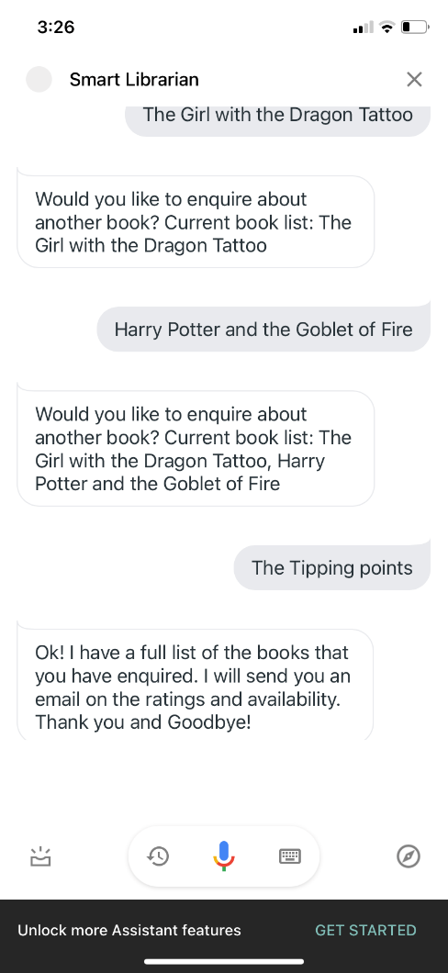
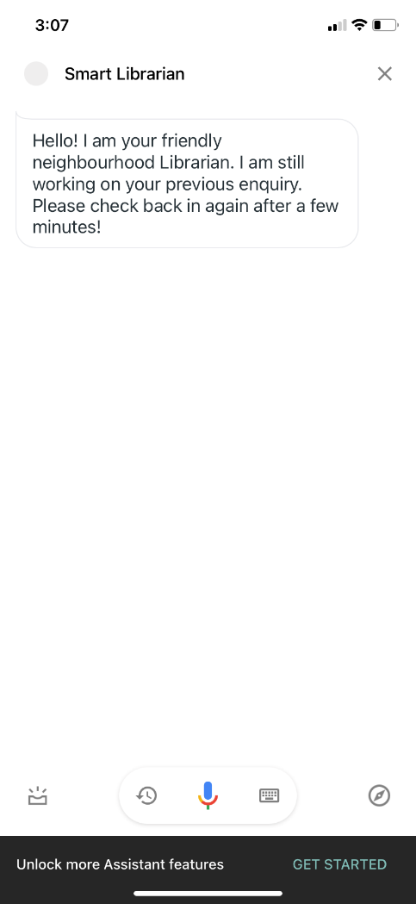
Conversational UI Architecture
Welcome Intent
Python Webhook Thread
Flask Library
Set Output Context:
Expecting Book Title
GetBookTitle Intent
Add to Book List
Set Output Context:
Follow up context – yes, no
No
Yes
Add to Book List
No
Set Output Context:
Follow up context – yes, no
Reset Context
Yes
Add to Book List
Book List Full
Reset Context
Triggers RPA Thread
Parallel RPA Thread
Trigger RPA
Welcome Intent
Ongoing query
Check presence of RPA Thread

Slide 4
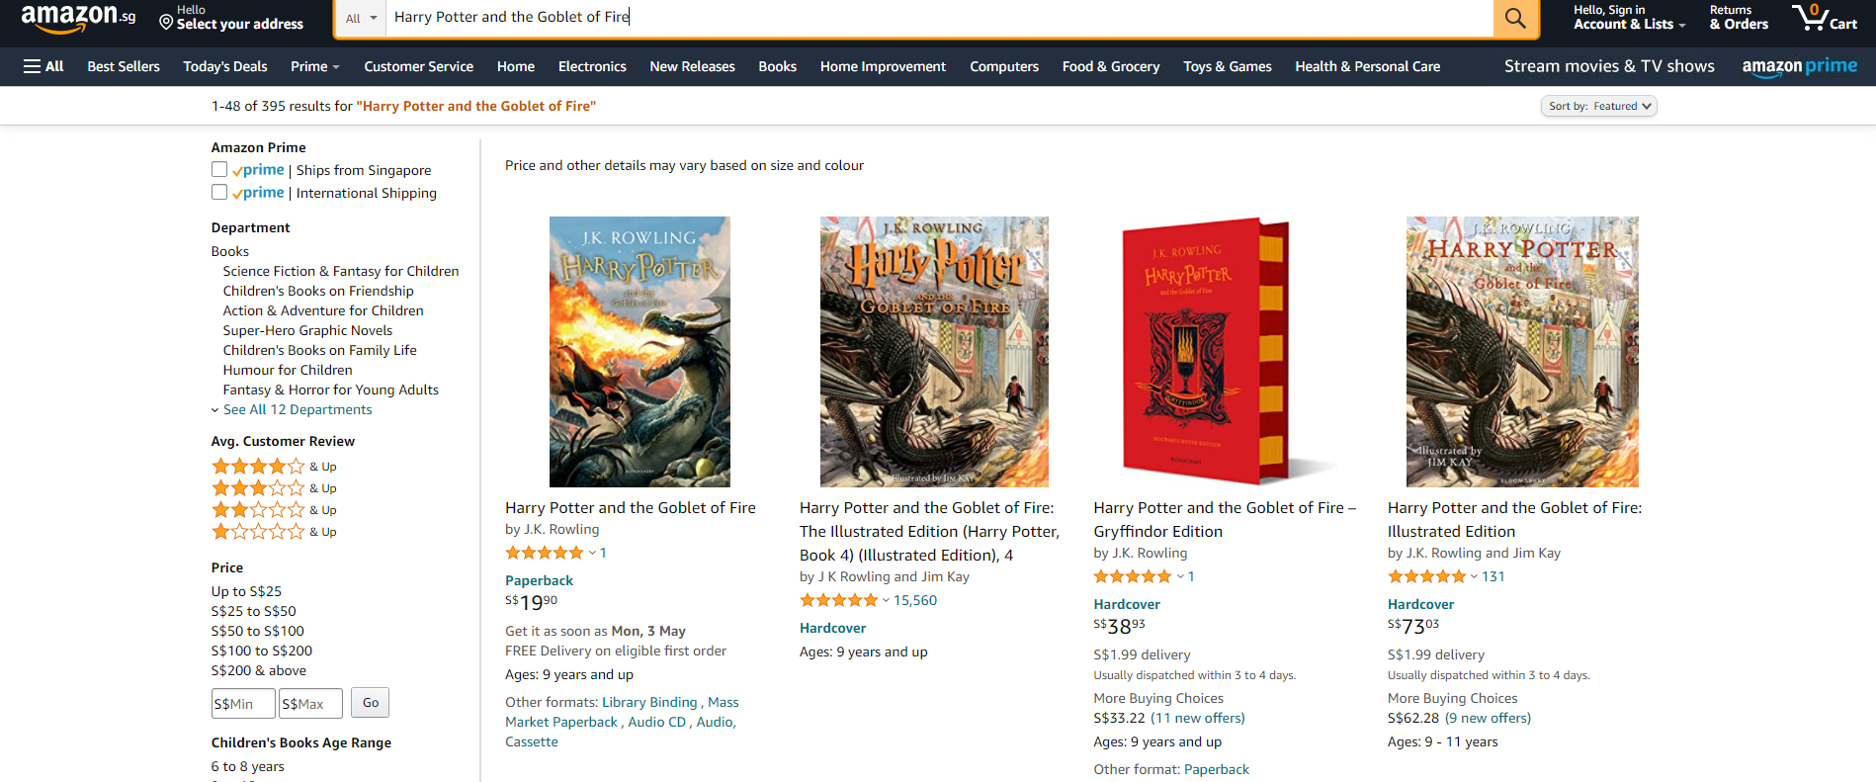
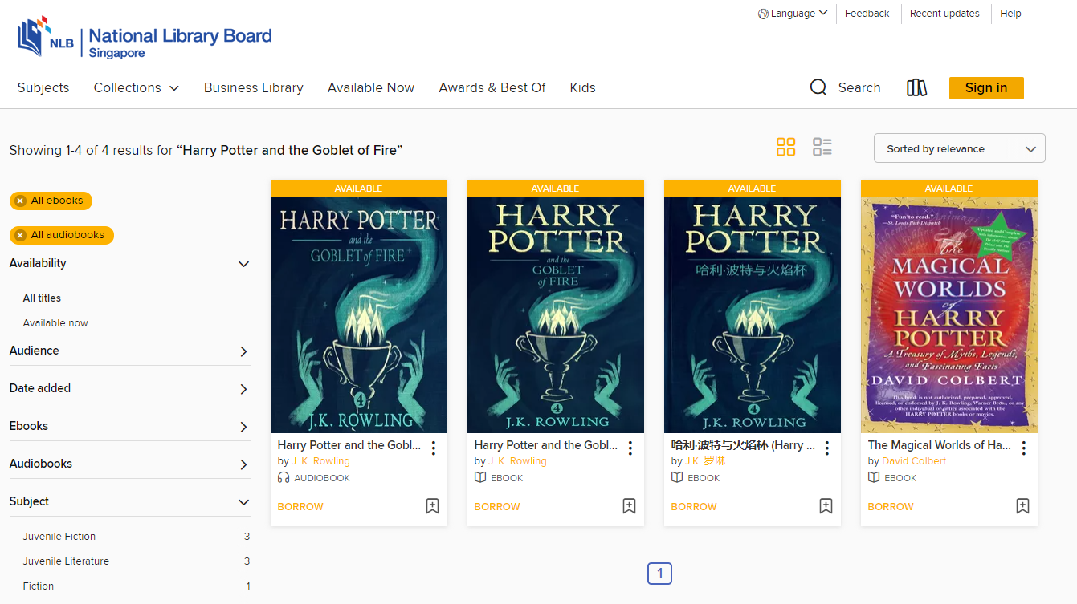
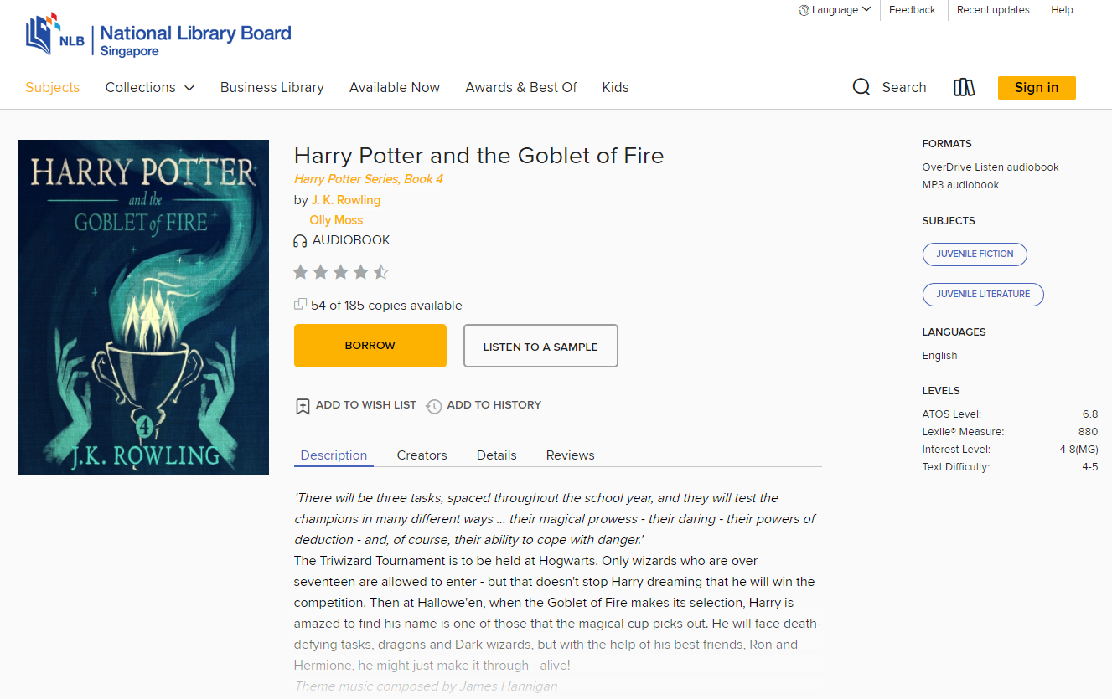
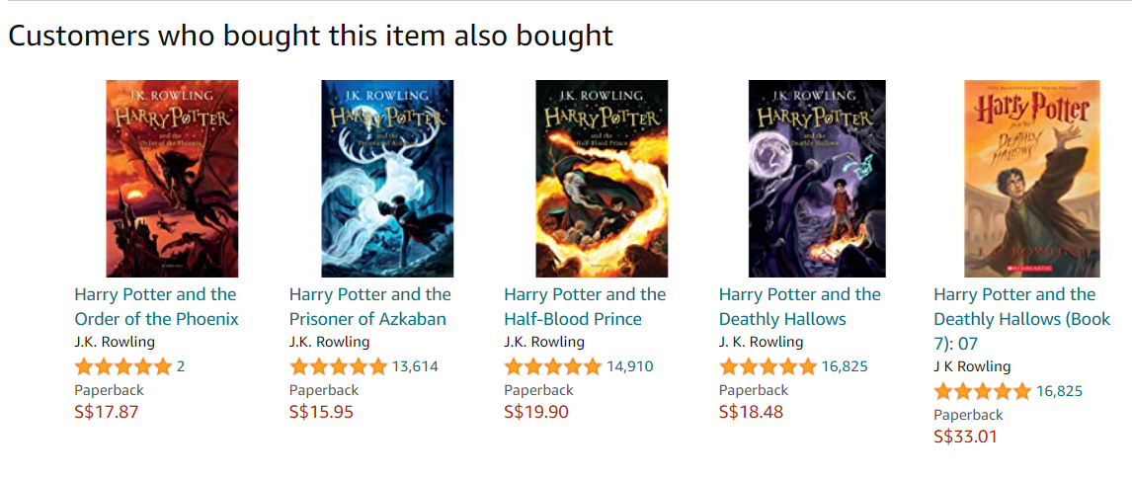
NLB Availability Checker & Amazon Recommendation System
NLB Availability Checker
Amazon Recommendation System
Controller (RPA.py) calls the NLB Availability Checker with the search term from booklist
Controller (RPA.py) calls the Amazon Recommendation System titles found from NLB
Search Term: Harry Potter and the Goblet of Fire
Search Term: Harry Potter and the Goblet of Fire
Open Amazon website to search for the books
Open NLB Site to search for available books
The titles presented might have slight variations from NLB and ordered different. The Intelligent Title Matcher is used to find the best matched title
For each book with the same title:
For the best matched title:
Clicked into
Information about Title, Author, Book Type, Availability, Ratings and Abstracts are extracted
Returns to the previous page
Access the other items that customers bought together with the book
Information for the recommended books are extracted.
Information found is returned to the Controller (RPA.py) in a dictionary.
Information found is returned to the Controller (RPA.py) in a dictionary.

Slide 5
Intelligent Title Matcher Abstract Summarizer
Preload the
WORD2VEC model
on application startup
Preload the pre-trained
BERT model
on application startup
Receive Original Title
Remove STOPWORDS and TOKENIZE remaining words
Receive the
FULL TEXT to be abstracted
Receive FULL TEXT
Generate WORD VECTORS for each token
Parameterize the
MAX LENGTH
of abstract
Aggregate Word Vectors to TITLE VECTORS
Extract
KEY SENTENCES
from text
Return Matching Title
Find shortest
COSINE DISTANCE between Titles
Concatenate sentences to generate
ABSTRACT
Return ABSTRACT

Slide 6
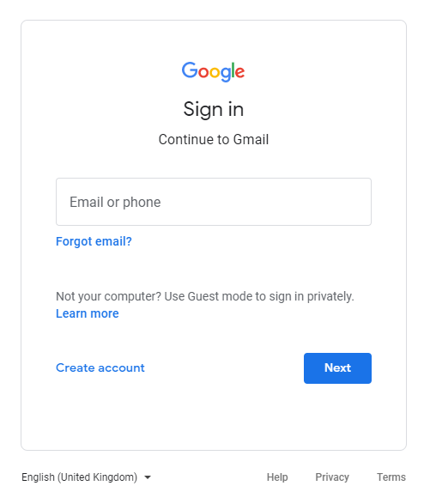
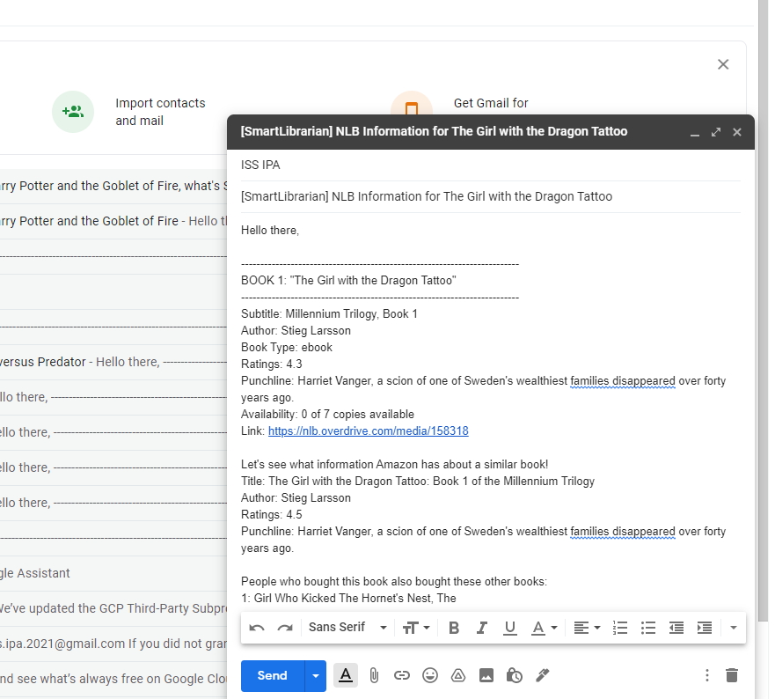

RPA: Email Agent
Direct to log in page for user to log in
Compose & Send Email
No
Amazon Information
Checks for Logged in Account
NLB Information
Yes
If no recipient detected in “email_recipient.txt”, obtain currently logged in email to store as recipient
Email Recipient

